Slide 1
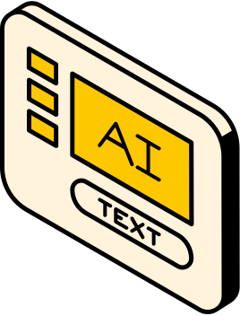
THYNK UNLIMITED
WE LEARN FOR THE FUTURE
DISEASE PREDICTION & MACHINE LEARNING
PRESENTATION
PRESENTED BY:
RAFAT ALKHATIB

Slide 2
INTRODUCTION
Imagine a world where machines can decipher languages, recognize faces, diagnose diseases, and even make predictions without explicit programming.
We will embark on a journey through the ever-evolving landscape of Artificial Intelligence and Machine Learning. We'll explore the core concepts, real-world applications, and the transformative potential of these technologies.

Slide 3
HISTORICAL CONTEXT
The problem and Task
The datasets and visualization
The models and metrics

Slide 4
WHAT IS THE PROBLEM?
Problem Statement: Predictive Modeling for Disease Diagnosis
Background:
Healthcare professionals often rely on various diagnostic tests and biomarkers to assess an individual's
health status and diagnose diseases. In this scenario, we have access to a dataset containing multiple
health-related attributes such as cholesterol levels, blood cell counts, hormone levels, and other
physiological measurements. The dataset also includes information on whether the individual has been
diagnosed with a specific disease or not.

Slide 5
WHAT ARE THE OBJECTIVE ?
Objective:
The objective of this project is to develop a predictive model that can accurately classify individuals into
diseased or non-diseased categories based on their health attributes. By leveraging machine learning
algorithms, we aim to create a reliable tool that healthcare providers can use to assist in disease
diagnosis and prognosis.

Slide 6
WHAT IS THE TASK?
Task:
Given this dataset, the task is to build a machine learning model capable of predicting the likelihood of
an individual having a specific disease based on their health attributes. The model's performance will be
evaluated using appropriate evaluation metrics such as accuracy, precision, recall, and F1-score.

Slide 7
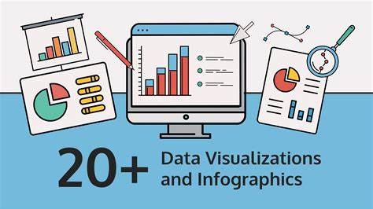

Slide 8
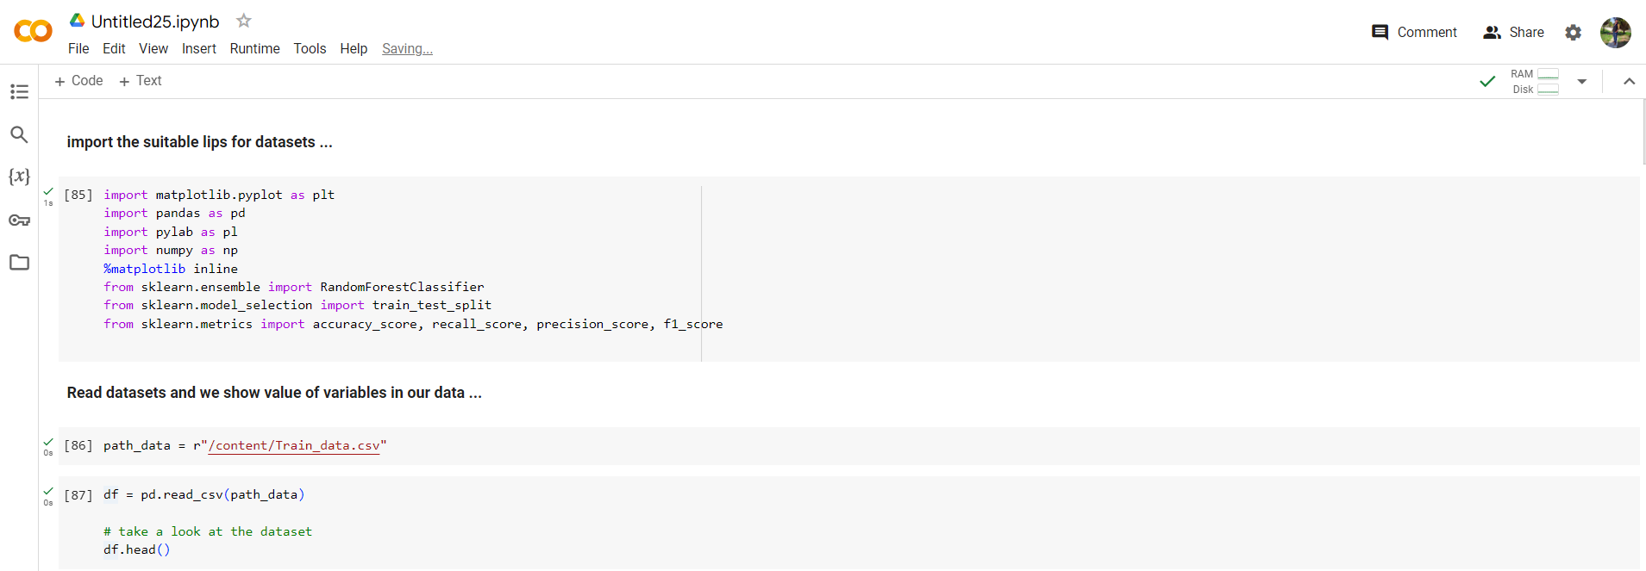
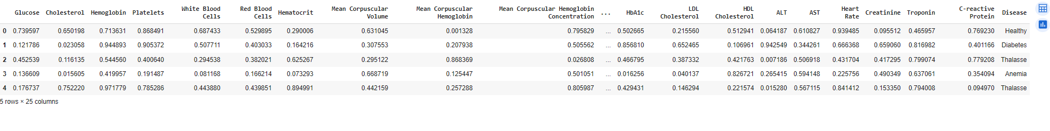
The suitable library
The Data Table

Slide 9
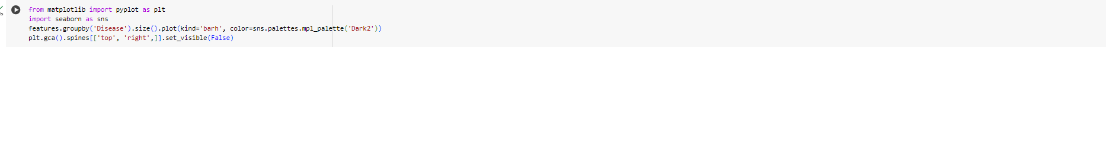
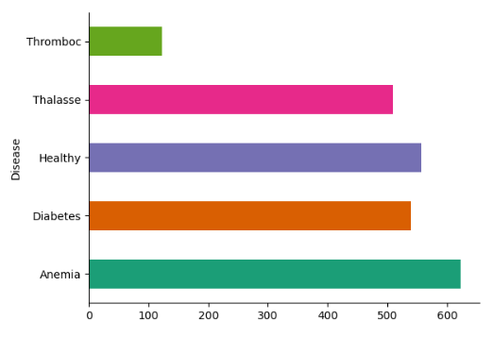

Slide 10
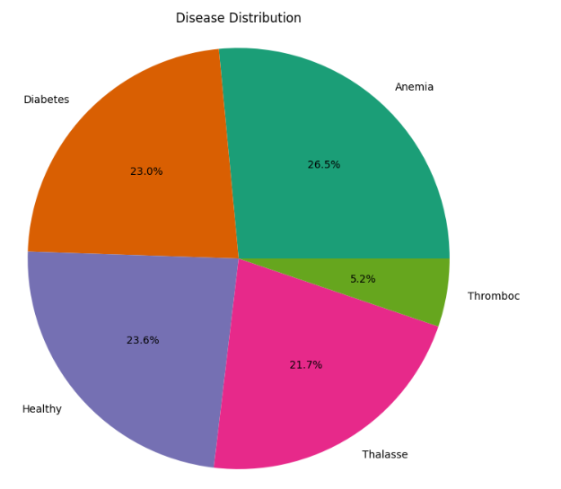

Slide 11
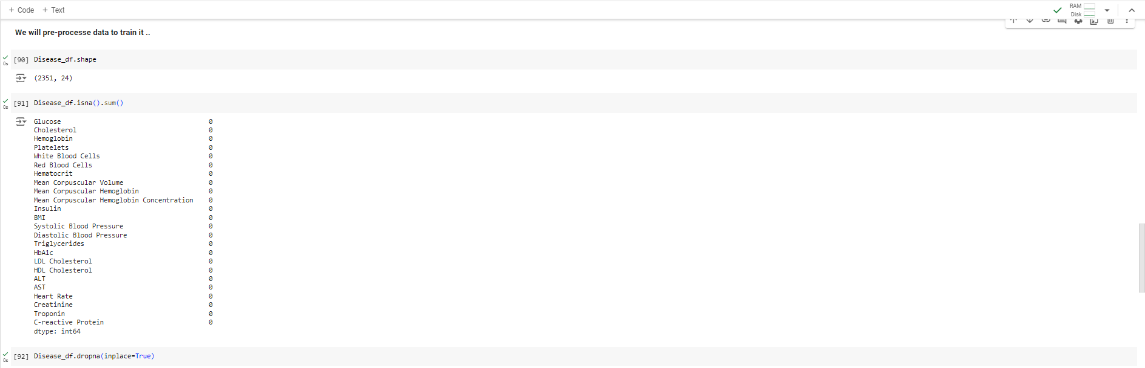
Pre-proccessing Data for Training

Slide 12
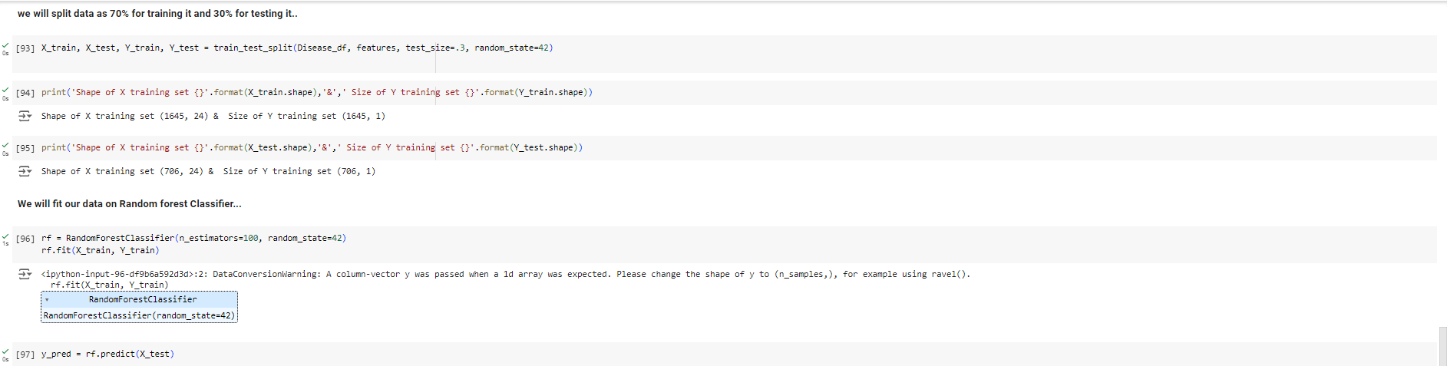
split data and classifier

Slide 13
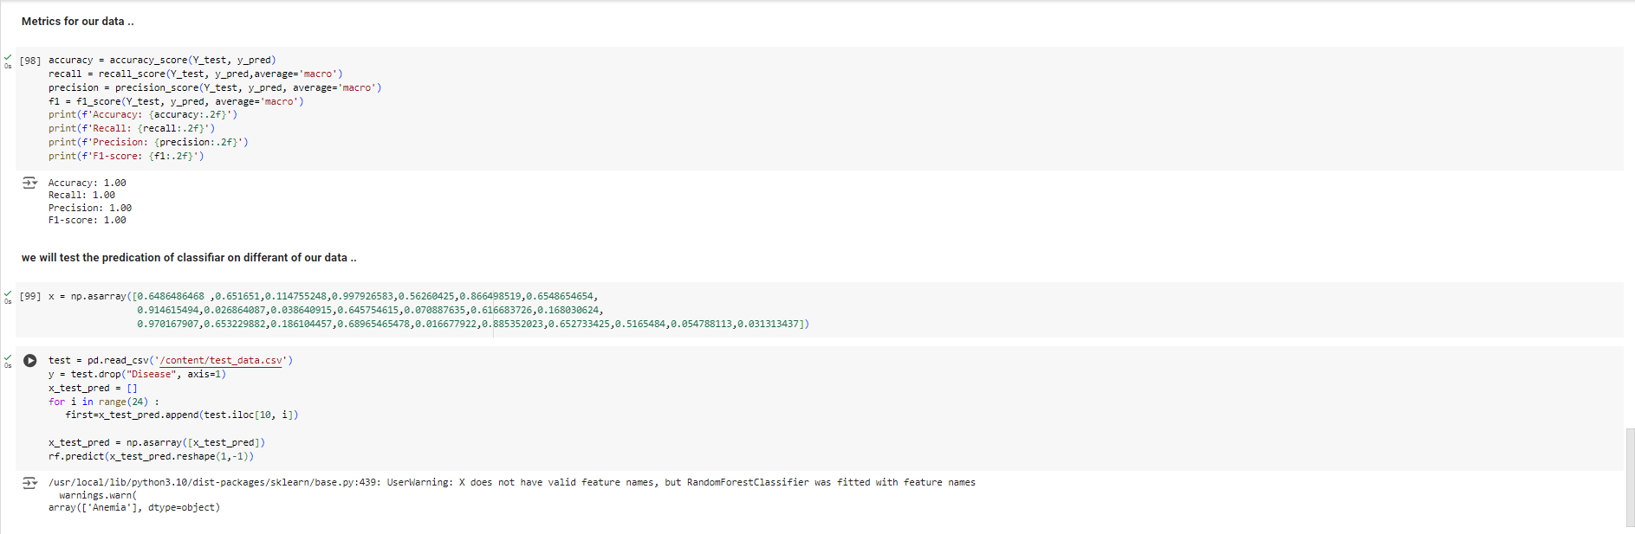
Metrics and Predication
Accuracy | Recall | precision | f1-score
1..00 | 1.00 | 1.00 | 1.00

Slide 14
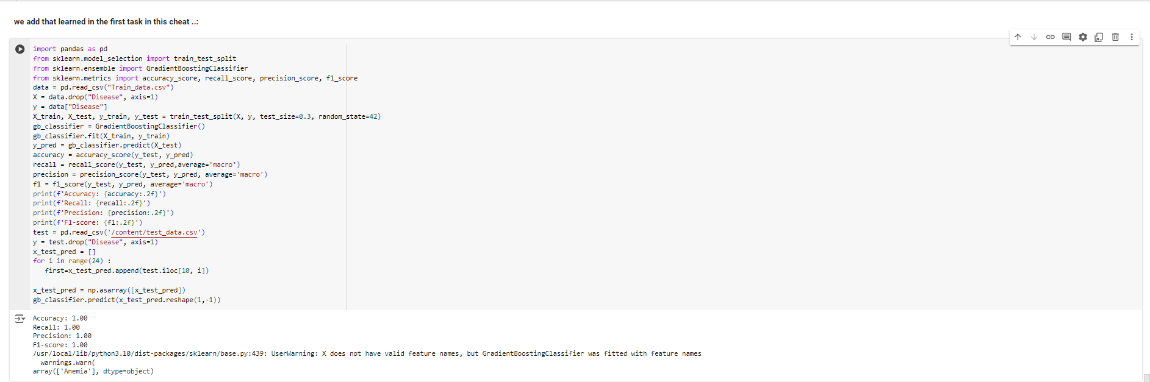
Add a gradient boosting

Slide 15


